Slide 1
Applications for Grad. School: 3 Key Components
BRAIN Camp
June 14, 2017

Slide 2
Applications for Grad. School: 3 Key Components
BRAIN Camp
June 14, 2017

Slide 3
3 Key Components of Applications for Graduate School
Curriculum Vitae (CV or vitae)
Personal Statement
Letters of recommendation

Slide 4
CV vs. Resume
“Tells the story of your academic life”
Focus: Only academic information that pertains to the program/your career
Do NOT include: babysitting experience, lifeguard job, membership in flag frisbee club
Length
Resume: One page
CV: 2+ pages with no length restrictions
Never include high school experiences or awards

Slide 5
CV: Basic Sections to Include
Heading: Contact Information
Name, address, e-mail, telephone number
Professional email only! (E.g., NOT poohbear123@gmail.com)
Name should be 1-2 font sizes bigger so it stands out
Include name on each page of your CV (footer)
Educational Background
List all earned academic degrees
Name of institution, location (city & state), degree type and major, month and year degree was (will be) awarded
Start with most recent
Exclude high school

Slide 6
CV: Basic Sections to Include Cont.
Teaching Experience
Courses taught, your title, institutions, and dates
1-3 bullet points: describe the course (if not clear) and your role in teaching it (e.g., created syllabus, lectured, graded exams/papers)
Research Experience
Institution, dates, faculty member under which research was conducted, topic or project title
1-3 bullet points: describe research, your activities/duties, accomplishments, resulting papers/presentations
Include formal research experience only (i.e., working under a faculty member)

Slide 7
CV: Basic Sections to Include Cont.
Publications
Citations for articles, chapters, research reports, etc. that you have authored or co-authored
Use format appropriate for your academic discipline (e.g., APA, MLA)
Start with most recent
Presentations
Talk title, name of conference, dates, and location
Use format appropriate for your academic discipline (e.g., APA, MLA)
Start with most recent

Slide 8
CV: Basic Sections to Include Cont.
Honors, Awards, Fellowships, Scholarships
Name of award, institution, year given, and brief explanation of criteria used to award it
Academic Service
Relevant university groups, committees, clubs you served on
Name of group, your role/activities, institution, dates
Professional Affiliations
List memberships in groups and professional societies, date of initial affiliation, and any administrative or leadership positions held
Skills or Languages
List any skills or languages relevant to your field (e.g., statistical programs, German fluency)
Note level of competency

Slide 9
CV: Formatting
Overall: well organized, easy to read
Keep styles, fonts, and abbreviation formatting consistent
Use short phrases, bullet points, and little punctuation
Use bolds, capitalization, italics, and underline to draw attention (but do not go overboard!)
Margins of 1” and 12-point font
Left-align the document
Footer with your name and page numbers in case pages get separated
Reverse chronological order!
Include information only for sections that apply to you
Consider combining sections (E.g., Papers and Publications)

Slide 10
CV: Final Considerations
Optional Sections:
E.g., Grants Received, Institutional Service, Qualifications/Training/Certifications
Review, review, review!
Have at least 3 people read/edit your CV
Update, update, update!
Make a habit of updating your CV after each accomplishment and experience

Slide 11
CV: Examples
Dos and Dont’s!

Slide 12
Personal Statement
Opportunity to personalize your applications
Narrative of your experiences and future academic/career goals
Potential Outline
Introduce yourself, your motivation for applying to graduate school
Experiences in academic career
Favorite classes
Research experiences--RA positions, thesis topic
Relevant work and internship experiences
Research interests/graduate school goals
Current research questions you’re interested in
How graduate school/faculty mentor are a good match

Slide 13
Do’s and Dont’s
Do’s
Pay attention to instructions
Some schools lay out exact guidelines
Write in active voice
Be clear, straightforward, and generally positive!
Proofread and ask others to read before you submit!
Dont’s
Re-write your CV in prose
Write in cliches
Embellish any details

Slide 14
Letters of Recommendation
Step 1: Figure out how many you need
Can be found on program application website
Step 2: Decide who you will ask
Someone who knows you well
Can speak to academic performance, volunteer experiences, future academic and career goals, personality and work ethic
Avoid professors from large lecture halls who you didn’t interact with
Step 3: Provide helpful information
List of schools/advisors you’re applying to
Deadlines
An up-to-date resume/CV and personal statement (academic/career goals)
Unofficial transcript/list of courses
How many years you’ve worked with them, if applicable

Slide 15
For example...
Undergraduate Advisor
Involvement in research
How I compare to other undergrads
Undergraduate courses and GPA
Primary Advisor during Post-Bacc RA position
Research responsibilities (i.e. coordinating research projects, conducting data analyses)
Clinical experiences
Readiness for grad school, GRE score, poster presentations
Professor I TA’ed for
Organization skills
Guest lectured a few classes
How I work with students

Slide 16
Do’s and Dont’s
Do’s
Try to diversify your experiences
Well-rounded applicant
Keep in touch with/update mentors even after you’ve stopped working with them
Check In and Follow up
Dont’s
Wait last minute to ask for a reference
Give several weeks
Assume they will be willing to provide a strong recommendation
Always best to ask!

Slide 17
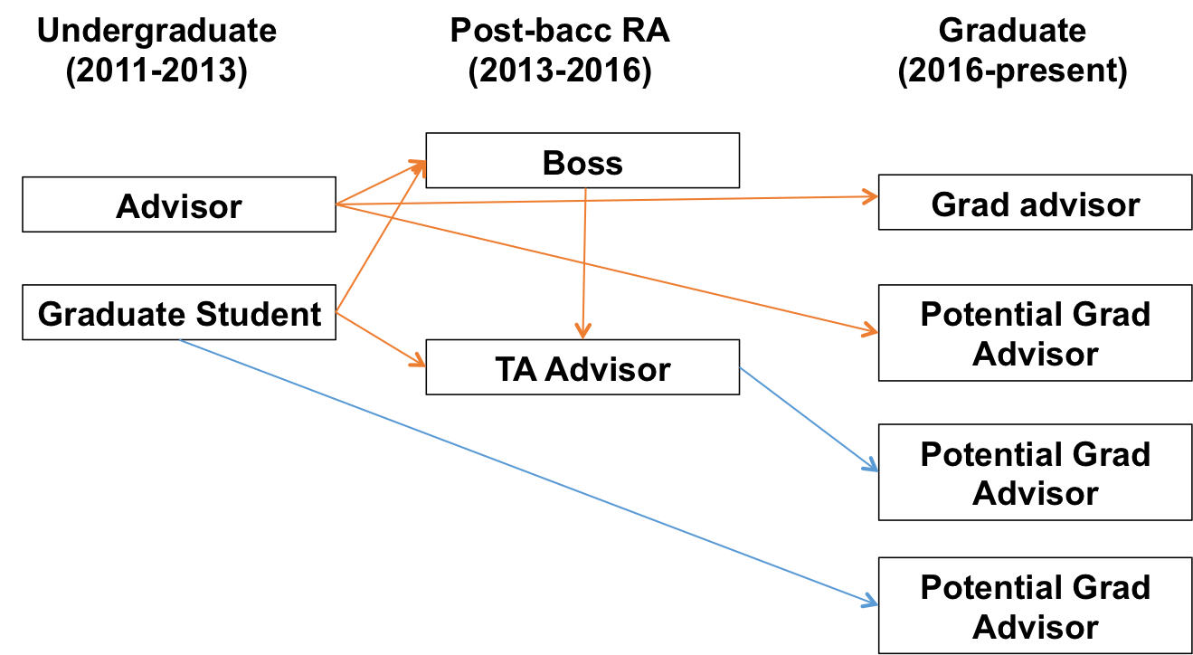
One thing to keep in mind...

Slide 18
Questions?

Slide 19
3 Key Components of Applications for Graduate School
Curriculum Vitae (CV or vitae)
Personal Statement
Letters of recommendation

Slide 20
CV vs. Resume
“Tells the story of your academic life”
Focus: Only academic information that pertains to the program/your career
Do NOT include: babysitting experience, lifeguard job, membership in flag frisbee club
Length
Resume: One page
CV: 2+ pages with no length restrictions
Never include high school experiences or awards

Slide 21
CV: Basic Sections to Include
Heading: Contact Information
Name, address, e-mail, telephone number
Professional email only! (E.g., NOT poohbear123@gmail.com)
Name should be 1-2 font sizes bigger so it stands out
Include name on each page of your CV (footer)
Educational Background
List all earned academic degrees
Name of institution, location (city & state), degree type and major, month and year degree was (will be) awarded
Start with most recent
Exclude high school

Slide 22
CV: Basic Sections to Include Cont.
Teaching Experience
Courses taught, your title, institutions, and dates
1-3 bullet points: describe the course (if not clear) and your role in teaching it (e.g., created syllabus, lectured, graded exams/papers)
Research Experience
Institution, dates, faculty member under which research was conducted, topic or project title
1-3 bullet points: describe research, your activities/duties, accomplishments, resulting papers/presentations
Include formal research experience only (i.e., working under a faculty member)

Slide 23
CV: Basic Sections to Include Cont.
Publications
Citations for articles, chapters, research reports, etc. that you have authored or co-authored
Use format appropriate for your academic discipline (e.g., APA, MLA)
Start with most recent
Presentations
Talk title, name of conference, dates, and location
Use format appropriate for your academic discipline (e.g., APA, MLA)
Start with most recent

Slide 24
CV: Basic Sections to Include Cont.
Honors, Awards, Fellowships, Scholarships
Name of award, institution, year given, and brief explanation of criteria used to award it
Academic Service
Relevant university groups, committees, clubs you served on
Name of group, your role/activities, institution, dates
Professional Affiliations
List memberships in groups and professional societies, date of initial affiliation, and any administrative or leadership positions held
Skills or Languages
List any skills or languages relevant to your field (e.g., statistical programs, German fluency)
Note level of competency

Slide 25
CV: Formatting
Overall: well organized, easy to read
Keep styles, fonts, and abbreviation formatting consistent
Use short phrases, bullet points, and little punctuation
Use bolds, capitalization, italics, and underline to draw attention (but do not go overboard!)
Margins of 1” and 12-point font
Left-align the document
Footer with your name and page numbers in case pages get separated
Reverse chronological order!
Include information only for sections that apply to you
Consider combining sections (E.g., Papers and Publications)

Slide 26
CV: Final Considerations
Optional Sections:
E.g., Grants Received, Institutional Service, Qualifications/Training/Certifications
Review, review, review!
Have at least 3 people read/edit your CV
Update, update, update!
Make a habit of updating your CV after each accomplishment and experience

Slide 27
CV: Examples
Dos and Dont’s!

Slide 28
Personal Statement
Opportunity to personalize your applications
Narrative of your experiences and future academic/career goals
Potential Outline
Introduce yourself, your motivation for applying to graduate school
Experiences in academic career
Favorite classes
Research experiences--RA positions, thesis topic
Relevant work and internship experiences
Research interests/graduate school goals
Current research questions you’re interested in
How graduate school/faculty mentor are a good match

Slide 29
Do’s and Dont’s
Do’s
Pay attention to instructions
Some schools lay out exact guidelines
Write in active voice
Be clear, straightforward, and generally positive!
Proofread and ask others to read before you submit!
Dont’s
Re-write your CV in prose
Write in cliches
Embellish any details

Slide 30
Letters of Recommendation
Step 1: Figure out how many you need
Can be found on program application website
Step 2: Decide who you will ask
Someone who knows you well
Can speak to academic performance, volunteer experiences, future academic and career goals, personality and work ethic
Avoid professors from large lecture halls who you didn’t interact with
Step 3: Provide helpful information
List of schools/advisors you’re applying to
Deadlines
An up-to-date resume/CV and personal statement (academic/career goals)
Unofficial transcript/list of courses
How many years you’ve worked with them, if applicable

Slide 31
For example...
Undergraduate Advisor
Involvement in research
How I compare to other undergrads
Undergraduate courses and GPA
Primary Advisor during Post-Bacc RA position
Research responsibilities (i.e. coordinating research projects, conducting data analyses)
Clinical experiences
Readiness for grad school, GRE score, poster presentations
Professor I TA’ed for
Organization skills
Guest lectured a few classes
How I work with students

Slide 32
Do’s and Dont’s
Do’s
Try to diversify your experiences
Well-rounded applicant
Keep in touch with/update mentors even after you’ve stopped working with them
Check In and Follow up
Dont’s
Wait last minute to ask for a reference
Give several weeks
Assume they will be willing to provide a strong recommendation
Always best to ask!

Slide 33
One thing to keep in mind...

Slide 34
Questions?

